Slide 1

Playroom - Children's Events Agency
Web Dev I PHP FINAL PROJECT
TEAM 6 – Siyi Chen & Chihyin Chen
1
Notes:
Hello everyone. I am glad to introduce our project with all of you. This is our web developer php final project and as you know our project is focus on Children event organize. This project is built by siyichen and Chihyin chen! Me siyi is more focus on the customer side and the css styles and chihyin, my best teammate focus more on the admin side and the login and register page.

Slide 2


What we do? What we provide?
Organize events for kids
Provide a safe play area for children
Offer professional organizers to guide kids in playing deeply
2
Notes:
We are a website organized different kinds of events for kids. Their Parent can call us to book the event or book events online.
We provide many safe play area and professional organizers whos kind and patient to organize our events!
We have many pictures in our website and full of information to let our customer feel we are a professional team

Slide 3

Our features & functionalities
Customer side
Events browsing and booking
Online Payment for bookings
Manage the bookings
Admin side
Manage users
Manage events
Manage bookings
3
Notes:
We have customer side and admin side to built our complete website. Here is the functionalities we have. For the customer side we have event browsing and booking , after customer find the event they are interested they can payment online to book it. They can also manage their booking after payment. To edit their booking information and even cancel it.

Slide 4
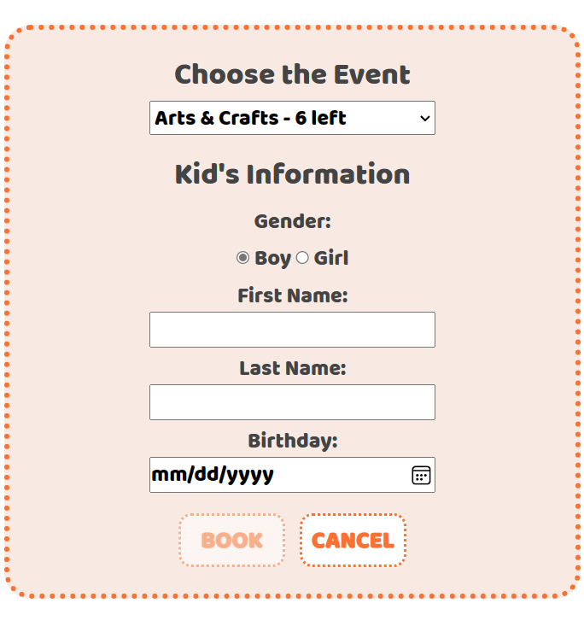
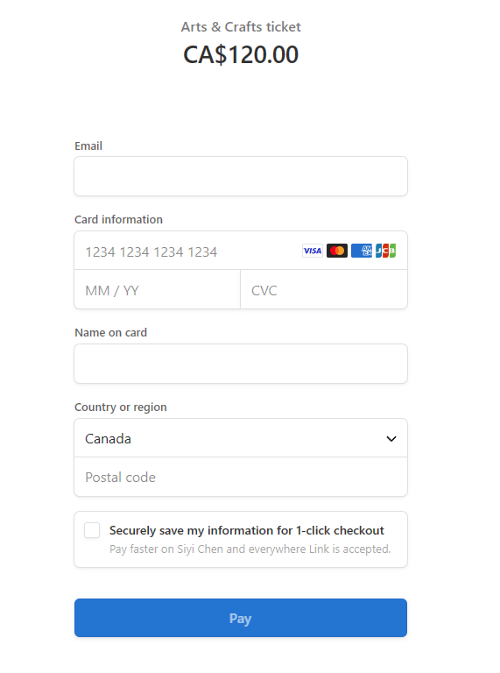
Online booking and payment
4
Notes:
Here are the two screenshots show our online booking and payment looks like.

Slide 5
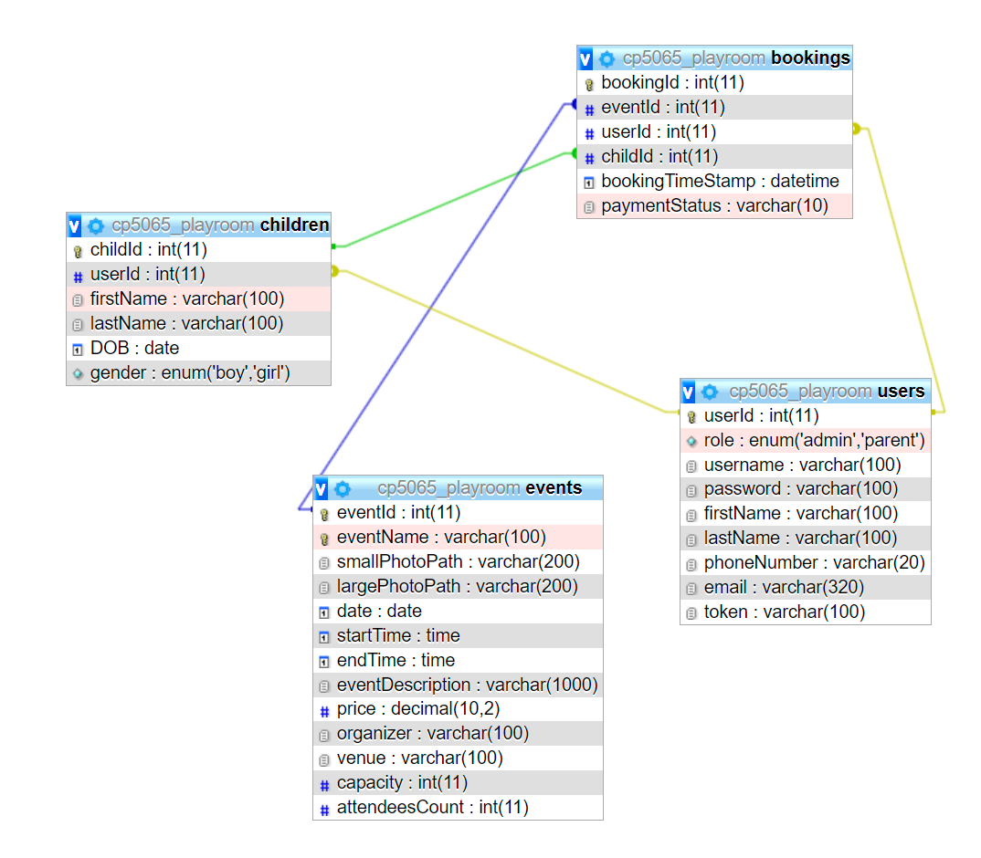
URL
5
Notes:
Here is the url of our project. We have four tables. The events table contains all of our business products. and have capacity and attendeesCount rows which can let us manage our events. We also have two photos for the event. One is for the event list page and the other is for the event information page. We have different role for user. The children table is belongs to the user table. And the bookings we include all of the id from other tables as foreign keys. The payment status is return by stripe, I will talk about it later.

Slide 6
Customer Side -Challenges and Solutions
6
Notes:
So I will talk about the customer side challenges and solutions first and later on my teammate will talk about more on admin side. For the customer side the first challenge I met is implement the validation with AJAX.

Slide 7
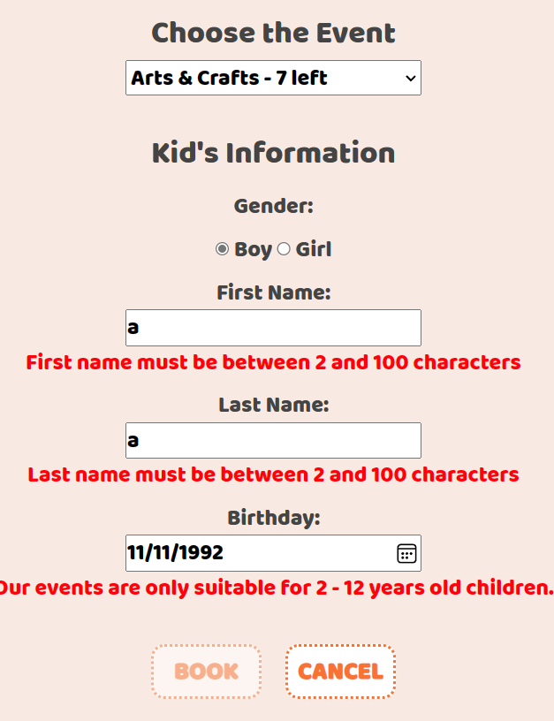
Form validation with AJAX
7
Notes:
This is the final version I did - as you see I displayed in the demo. I do both the front-end and back-end validation on this form. Ajax can display when the customer input the wrong answer.

Slide 8
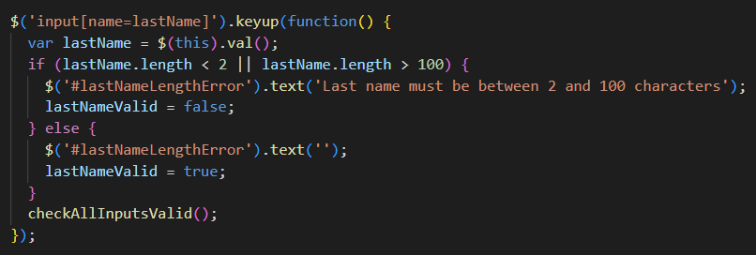

Form validation with AJAX
8
Notes:
This is the code that I use. These are the codes look like in the form. Ajax just control the content of the input. The variable lastname is the value customer input. These are the condition to show the message in the span which names lastName lenthError. This is how lastname error message works.

Slide 9
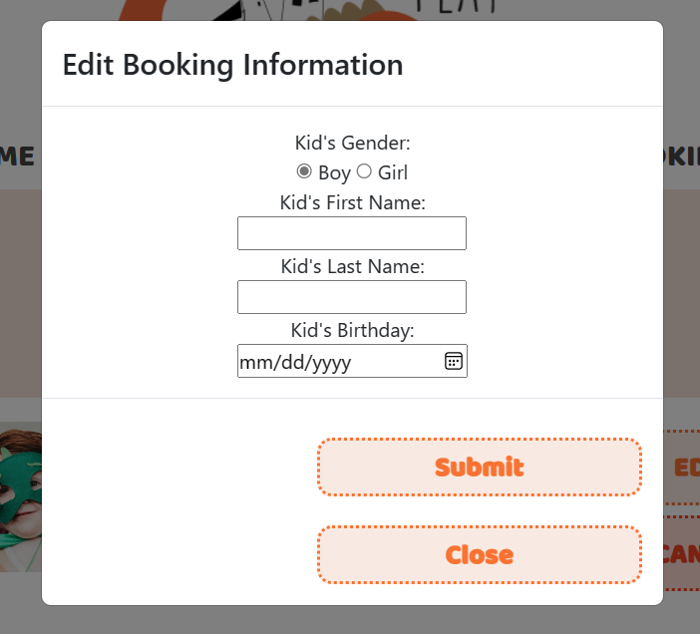
Edit booking using modal
9
Notes:
Another challenge for me is the modal form part. The validations are the same but edit function need to get the id of the booking I’d like to update and this pages shows many bookings of this customer.

Slide 10
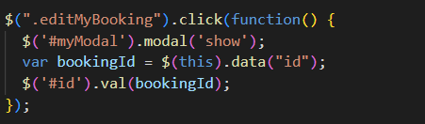
10
Notes:
This is our final solution. The bookings are showing out by loop, each booking have their own bookingId. The function click on editMyBooking button make the modal form shows. And get the bookingId from the button data-id.

Slide 11
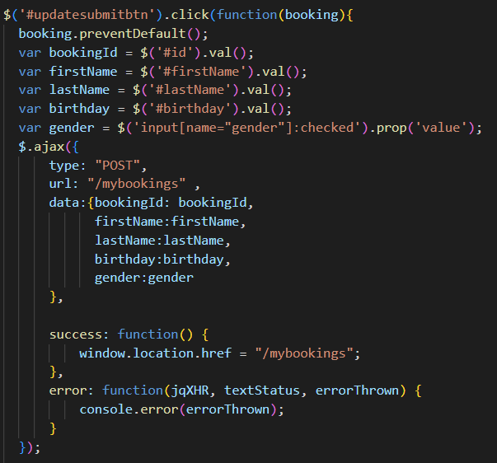
11
Notes:
The updateSubmitbutton is in the modal form. Still use Ajax. We have a function click on that button to submit the values that customer input. The gender field is selected using the input[name="gender"]:checked selector, which selects the radio button with the checked attribute. We get the contents they input. And make AJAX POST request to the server at the URL /mybookings.

Slide 12
Customer Side - Learned and Teach
12
Notes:
What I learned and what I can teach. The thing comes in my mind first is the online payment prosessing which we use is Stripe. To pay online using stripe, we have to have an account with stripe, using test mode and get the secret key. We use stripe check out and stripe webhook to impletment our payment. As team three is already talk about a lot about stripe. I will not show the stripe page to waste the time. Here I have the codes about using stripe api.

Slide 13
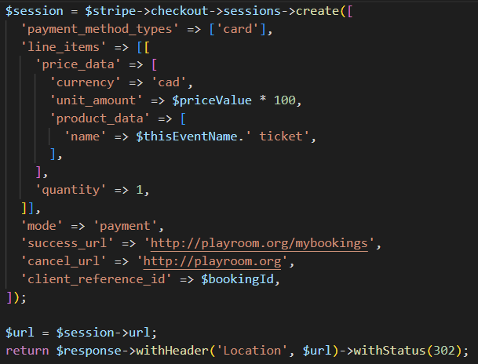
Online Payment with Stripe
13
Notes:
After we have the key. We create a checkout session to send it to stripe when the payment prosessing start. We can put the information in this session so that the stripe will shows the order details to customer.

Slide 14
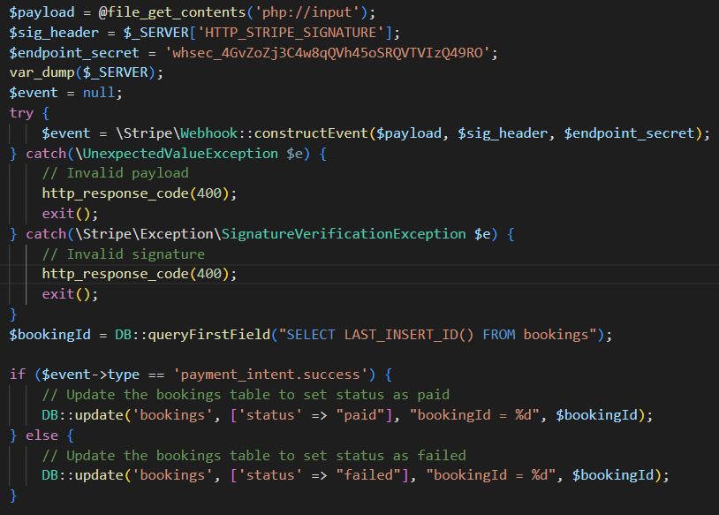
14
Notes:
These codes are from the stripe document. We use stripe webhook to get the payment information from stripe and use it for our website. Payload is a Jason string including payment, customer and order information. The endpoint_secretkey is from stripe webhook not stripe check out. After try catch the error, if the event we get is payment_intent.success we update the status in bookings table as “paid”, else we have that status”failed”. Then our mybookings page will only shows paid bookings. That all for suctomer side. Now I will pass the rest to my teammate Jean to introduce more about admin side and login register page.

Slide 15
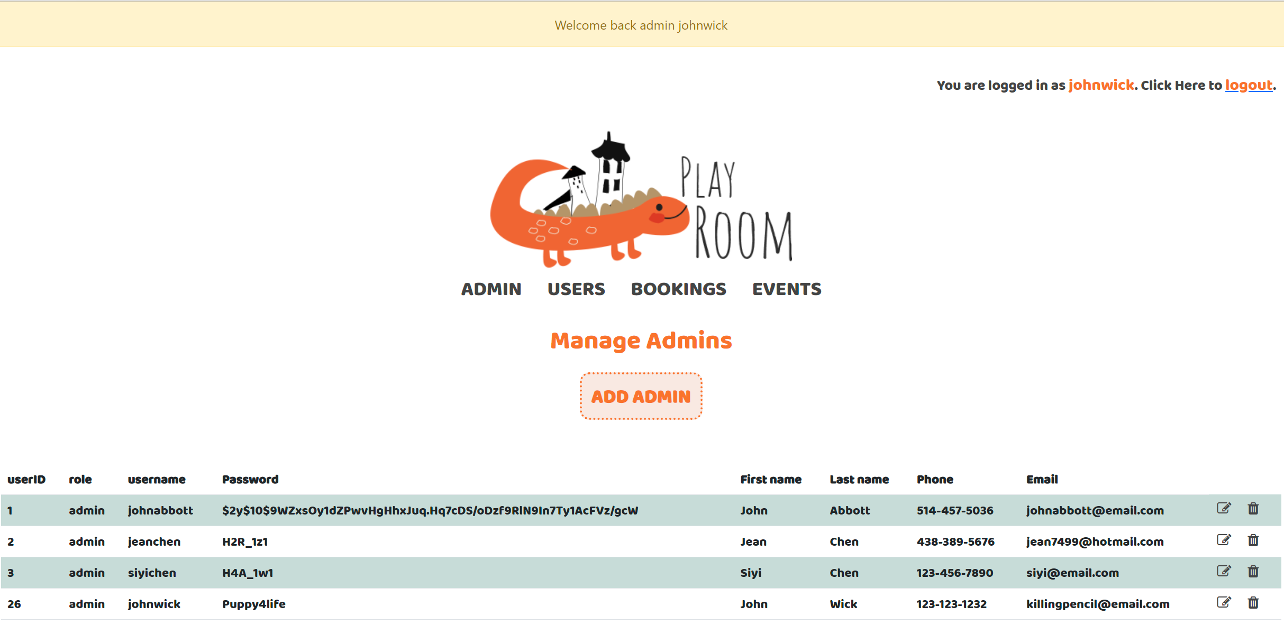
admin
Admin
Users
Bookings
events

Slide 16
challenges
Not directing to another page to add/delete
Reset password request
Website hosting

Slide 17
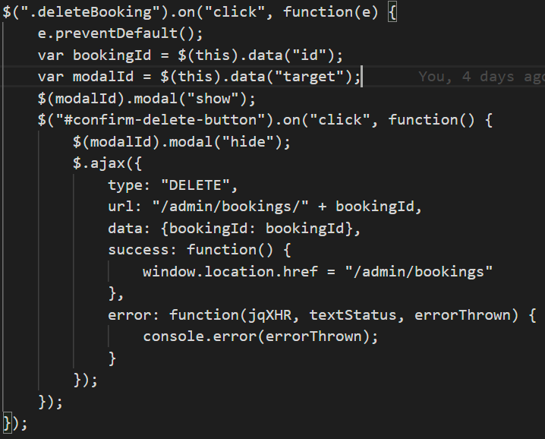
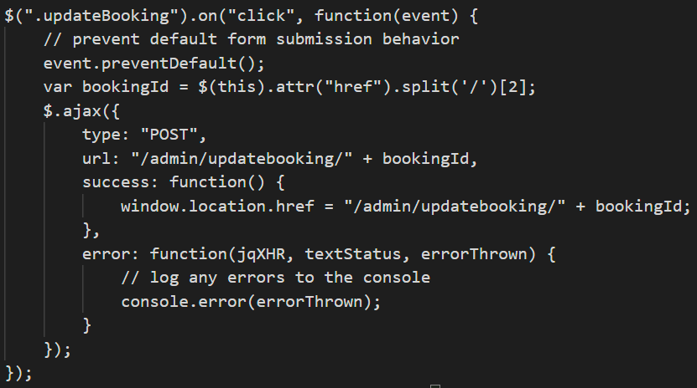
AJAX jQuery Modal

Slide 18
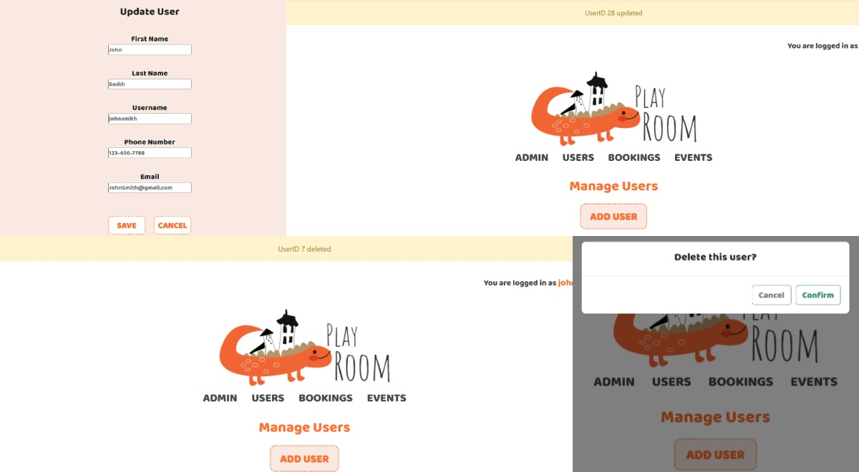





Slide 19
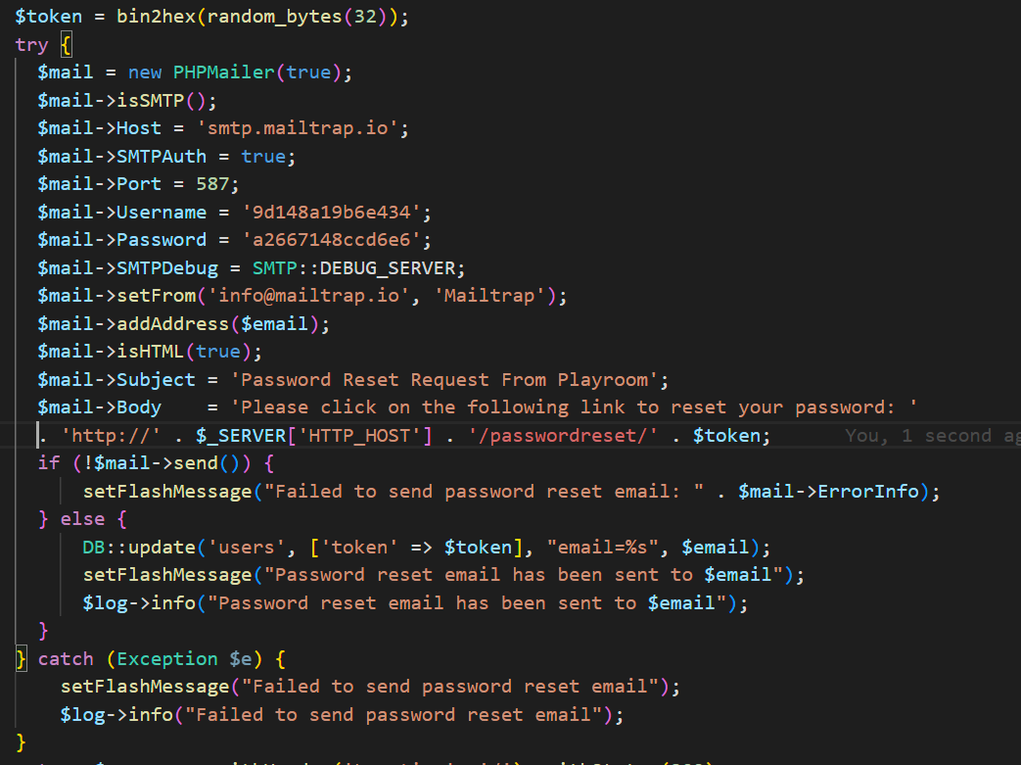
email password reset
Generate a token
Send the request email to the user via mailtrap api

Slide 20
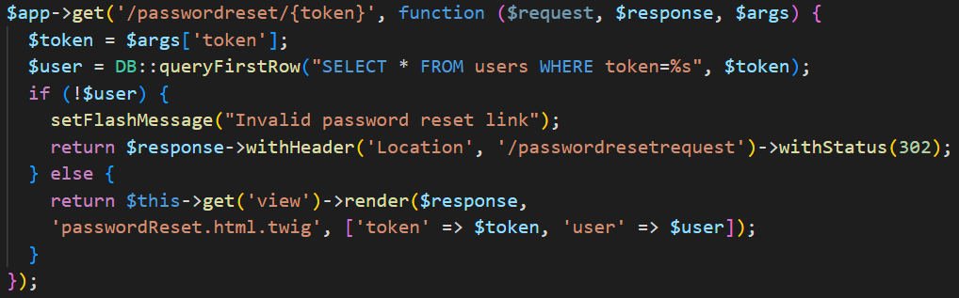
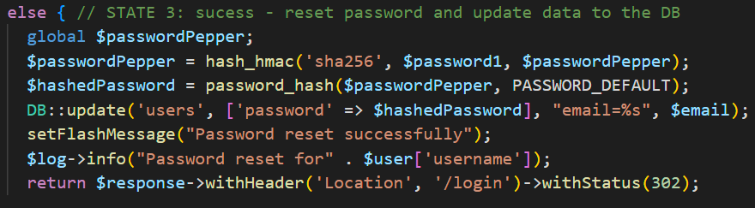
password reset request
Retrieve the link from email
only for authenticated user
Password hashed
Update users table
FlashMessage and log

Slide 21
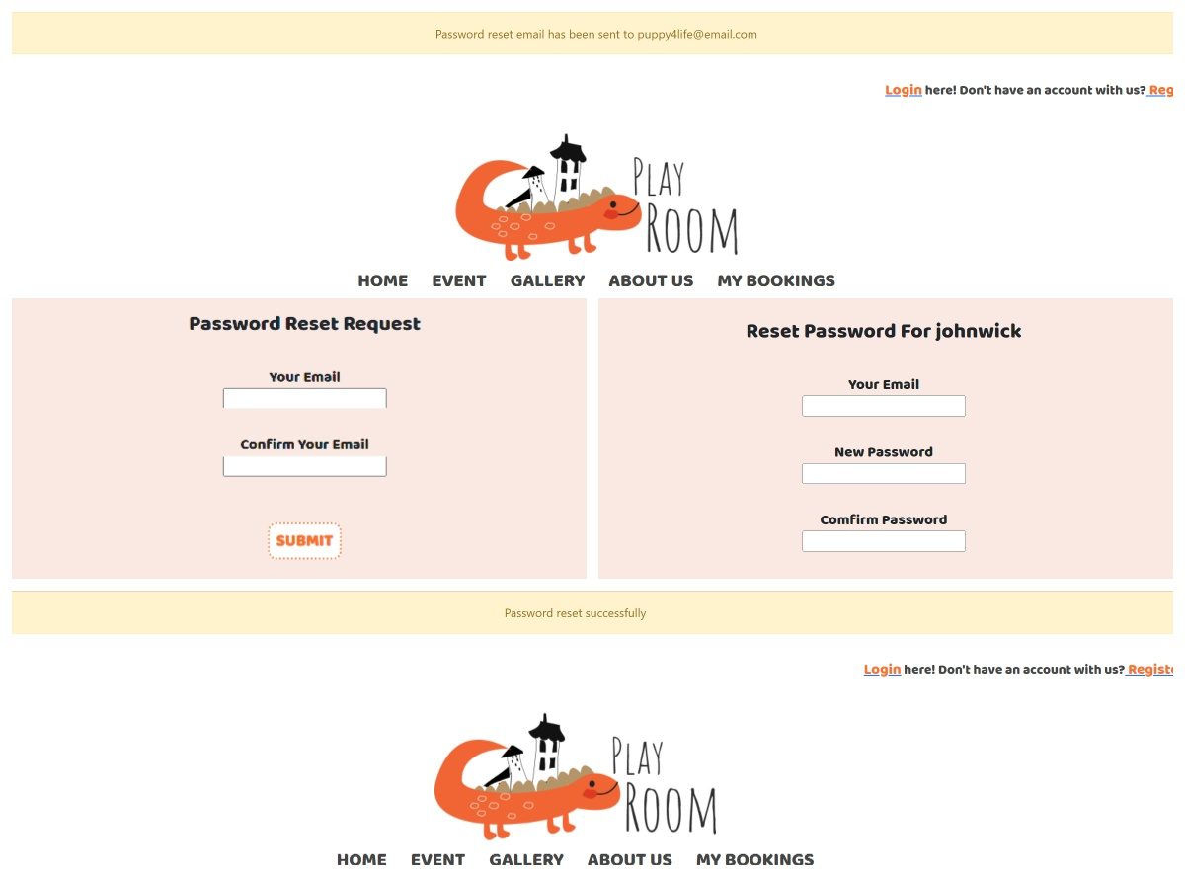

Slide 22
future enhancements
User edit profile
User edit children profile
Calendar function
Email a link to active account
Pagination

Slide 23
technologies used
Customer/Admin
Slim
Twig
Meekrodb
Monolog
Flash
Stripe
Phpmailer
bootstrap
Google Maps
Ajax
jQuery
Create
Read
Update
Delete

Slide 24
thank you
ChihYin Chen
Siyi Chen
playroom.fsd07.com

